Slide 1



Class: IX Lab: 12
Python
Automating with Python

Slide 2



Automation
Automation is the technology by which a process or procedure is performed without human assistance

Slide 3

SMTP
Simple Mail Transfer Protocol (SMTP) is the protocol used for sending email

Slide 4
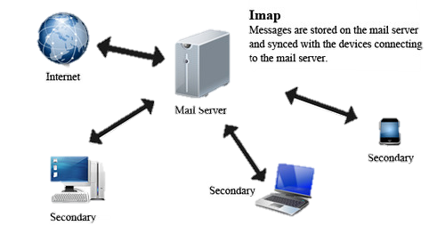
IMAP
Internet Message Access Protocol” is an Internet standard protocol used by email clients to retrieve email

Slide 5
Mailing Script
test_email.py / _____________________/ import smtplib from_address = "deepto69@gmail.com" to_address = "mahmud750@diu.edu.bd" message = "Hi! I am sending this email using python script" password = "type_your_pssword" server = smtplib.SMTP('smtp.gmail.com:587') server.starttls() server.login(from_address, password) server.sendmail(from_address, to_address, message) print("email sent successfully!") server.quit()

Slide 6
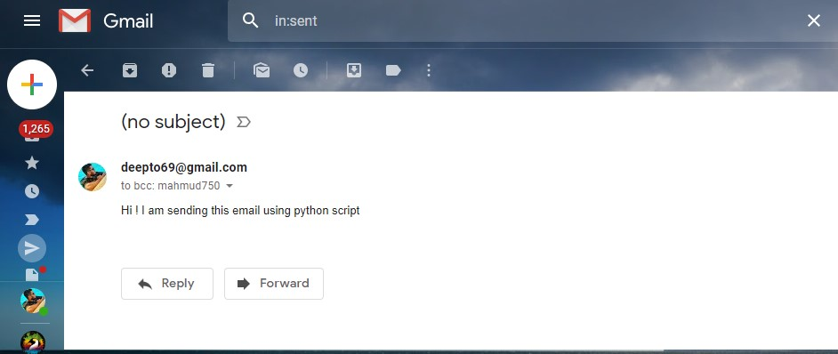
Confirmation

Slide 7
